Slide 1
COMP 90018 Mobile Computing Systems Programming
Tutorial on Android Development
Chu Luo, Ransi De Silva
chu.luo@unimelb.edu.au
ransidesilva@gmail.com

Slide 2
Welcome!
Outcomes of this tutorial:
Bluetooth
WiFi Direct (P2P in Android)
Socket, HTTP

Slide 3
1. Bluetooth

Slide 4
Android Supports:
Classic Bluetooth: short-distance radio communication
Bluetooth Low Energy: low-power sensors
API 18+ has BLE

Slide 5
Classic Bluetooth:
Available on most personal devices: smartphones, smartwatches, tablets, laptops

Slide 6
Bluetooth Main Components:
BluetoothAdaptor
BluetoothDevice
Bluetooth
ServerSocket
BluetoothSocket

Slide 7

Two Devices Build Connection:
Request
Server
Client
One must be server; the other client

Slide 8
Who be server?:
Let me be server
Users can decide which is server

Slide 9
Auto Connection Solution:
Server
Server
Both be server first

Slide 10
Auto Connection Solution:
Request
Server
Server
Client
Either requests as client

Slide 11
Auto Connection Solution:
Request
Server
Server
Client
Then, you have a connection

Slide 12
Android Bluetooth Setup:
Get permissions:
<uses-permission android:name="android.permission.BLUETOOTH" />
<uses-permission android:name="android.permission.BLUETOOTH_ADMIN" />
<uses-permission android:name="android.permission.ACCESS_COARSE_LOCATION" />

Slide 13
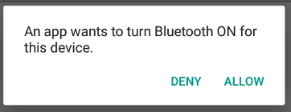
Then, get BluetoothAdapter:
Checks the hardware availability
Helps users switch it on if it is off

Slide 14
The next steps:
Find the other nearby device
(it must be discoverable)
Build connection using MAC address
Send/Receive data

Slide 15
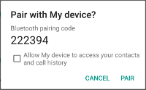
Connection will check if paired:
On both devices

Slide 16
Demo: Bluetooth

Slide 17
2. Wi-Fi Direct (P2P)

Slide 18
Wi-Fi Direct (P2P):
Android API 14+ has this feature
Devices communicate without AP
Similar to Bluetooth.
But Wi-Fi Direct has longer range.

Slide 19
Android Wi-Fi Direct API:
Also similar to Bluetooth.
WifiP2pManager

Slide 20
Get Permissions:
<uses-permission android:name="android.permission.ACCESS_WIFI_STATE" /> <uses-permission android:name="android.permission.CHANGE_WIFI_STATE" /> <uses-permission android:name="android.permission.CHANGE_NETWORK_STATE" /> <uses-permission android:name="android.permission.INTERNET" /> <uses-permission android:name="android.permission.ACCESS_NETWORK_STATE" />
Socket requires Internet permission

Slide 21
The next steps:
Check hardware availability
Find devices
Build connection using MAC address
Send/Receive data

Slide 22
Wi-Fi Direct: Connection as Group
One device is randomly/ manually selected as owner
Group
Owner
External Device
External device should find owner to join
Cilent
22

Slide 23
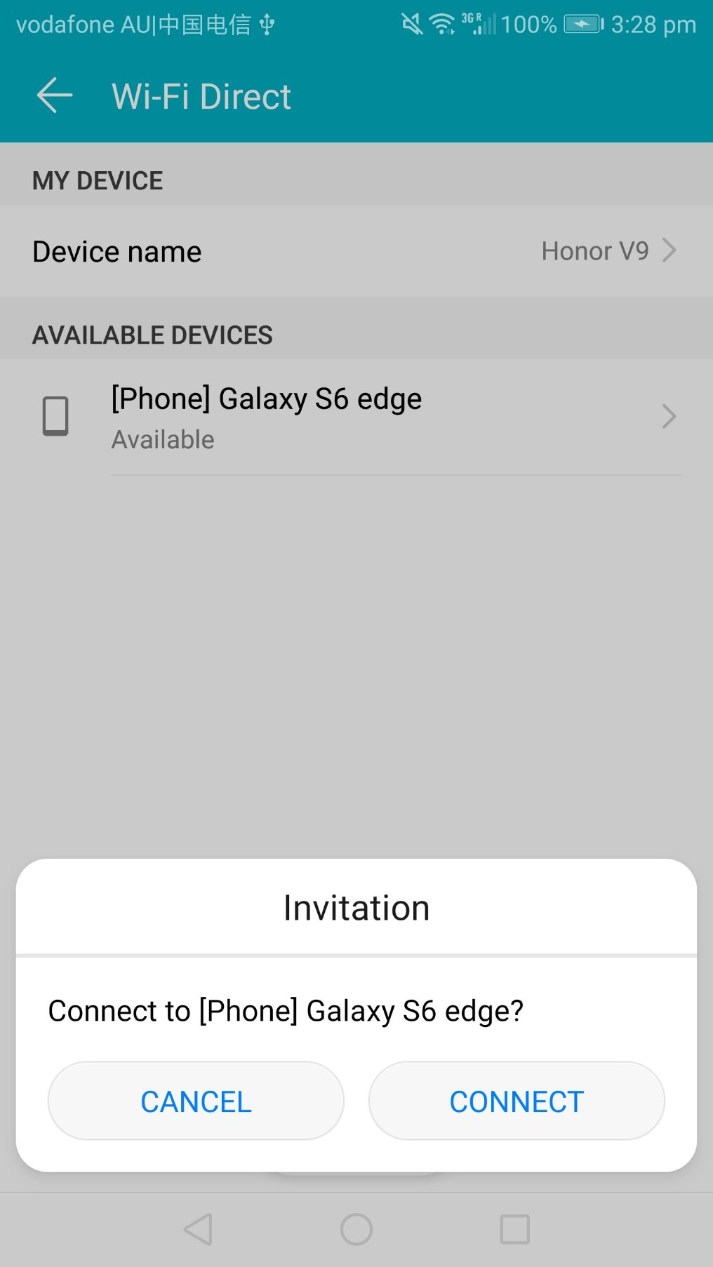
Auto Generated Confirmation

Slide 24
We can use Socket to send data in Wi-Fi Direct (or on the Internet)
24

Slide 25
Demo: Wi-Fi Direct

Slide 26
3. Socket, HTTP

Slide 27
HTTP
Application Layer
Socket
(As API)
Transport Layer
Network Layer
Data Link Layer
Physical Layer

Slide 28
Hypertext Transfer Protocol (HTTP)
Transmitting hypermedia on application layer
e.g., show webpages in browsers

Slide 29
Hypertext Transfer Protocol (HTTP)
Also used in Web Service, called RESTful (Representational State Transfer)
For machine-to-machine communication

Slide 30
Hypertext Transfer Protocol (HTTP)
1. Request
2. Response
Client
Server
Unlike Socket, server cannot actively send data

Slide 31
Java HTTP Package: Retrofit2
Optimised for RESTful
Provides GET/POST/… Method
URL: http://square.github.io/retrofit/

Slide 32
Demo: Retrofit2 using Translation Web Service

Slide 33
More to learn:
Connect devices in games
Up/Download Multimedia with servers (DIY or use cloud platform)
Handle failed connections

Slide 34
What About Next Week?
Cloud platform for mobile apps
Firebase
Azure

Slide 35
See you next week COMP 90018
Tutorial on Android Development
Chu Luo, Ransi De Silva
chu.luo@unimelb.edu.au
ransidesilva@gmail.com

